Slide 1
Python
Programming Language
How to tame it

Slide 2
Course Plan for Python
Python Basics
Python Advanced
Basic syntax and operations
Data Structures
Control Flow & Functions
Object oriented Programming
Python packages
Exception Handling
Regular Expressions, file handling, networking
web frameworks

Slide 3







Agenda
Introduction to Python
Who uses Python
Why
Python
Features of
Python
Setting up Python
Programming in Python
Points to remember

Slide 4






What is Python?
Interpreted, object-oriented, high-level programming language
Simple, Easy to learn Syntax
Program modularity and Code reuse
Powerful
Rapid Application Development
Extensive availability of Standards Libraries
Popular
Notes:
1. Python supports modules and packages, which encourages program modularity and code reuse
2. The Python interpreter and the extensive standard library are available in source or binary form without charge for all major platforms, and can be freely distributed.

Slide 5
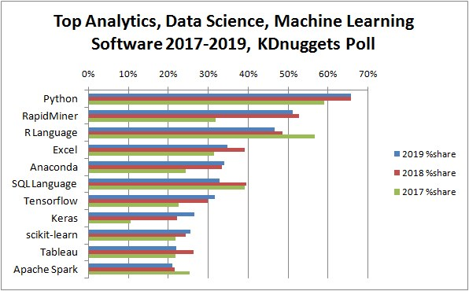
Python Stats
Python, R, and Other Platforms for Analytics, Data Science, Machine Learning
42%
41%
36%
34%
16%
12%
11%
8.5%
Source: https://www.kdnuggets.com/2019/05/poll-top-data-science-machine-learning-platforms.html
Notes:
Python stayed at the top, with almost the same share (65.8% vs 65.6%) of respondents as in 2018
R language share has declined 2 year in a row, but less this year than in the previous year
3. The shares for Deep Learning platforms Tensorflow and especially Keras have grown each year, reflecting the growing usage of Deep Learning in many applications

Slide 6
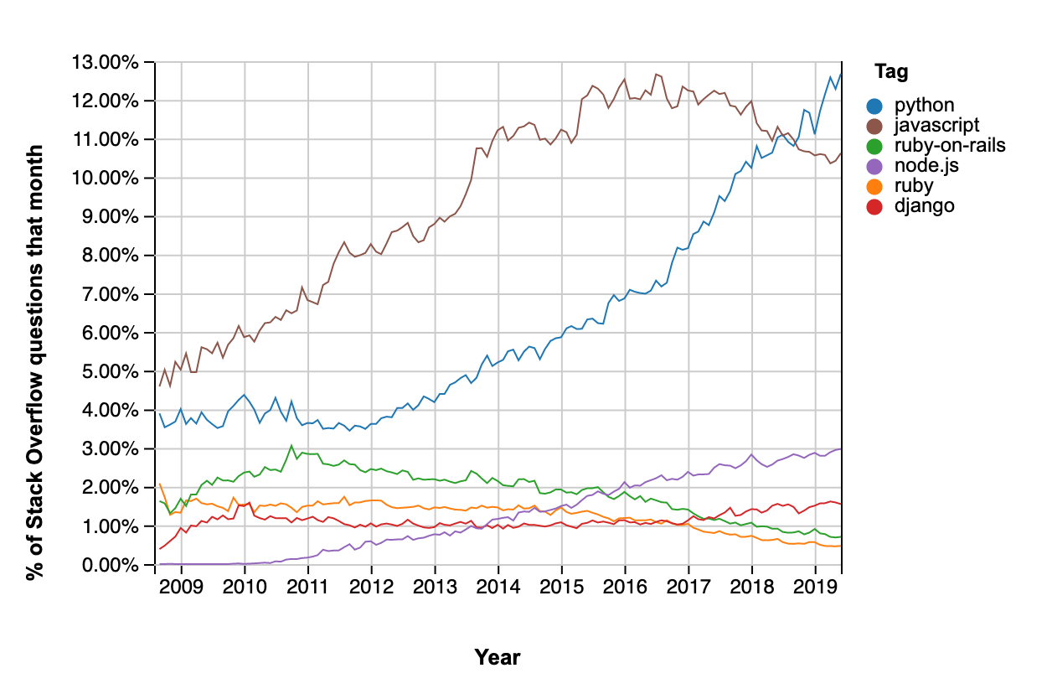
How popular is Python?
42%
41%
36%
34%
16%
12%
11%
8.5%
Source: https://www.monterail.com/blog/what-is-python-and-why-is-it-so-popular
Notes:
1. Python was licensed as open source. Thanks to its public and transparent development model, Python continues to improve and gain popularity.

Slide 7
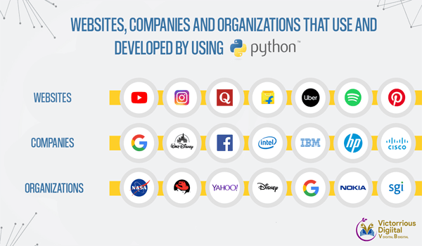
Python Stats
Source: https://www.victoriousdigital.in/python-the-next-level-of-programming-language/

Slide 8
History of Simplicity
Computer Programming for Everyone...
An easy and intuitive language just as powerful as major competitors
Open source, so anyone can contribute to its development
Code that is as understandable as plain English
Suitability for everyday tasks, allowing for short development times
Guido van Rossum
Notes:
Photo + vision <- Simplicity

Slide 9
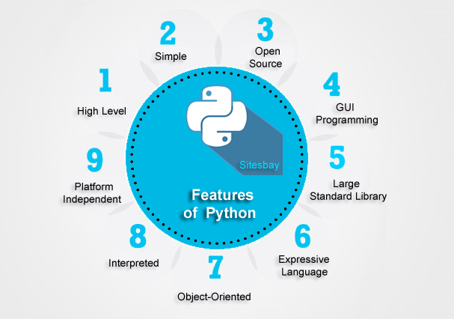
Features of Python
Source: https://pythonforbeginners123.wordpress.com/part-1/
Notes:
Photo + vision <- Simplicity

Slide 10




Where is Python used?
Web Scraping
Testing
Web Development
Data Analysis

Slide 11

Python 2.x Or Python 3.x
VS
Python 3.x
present and future of the language
Python 2.x
legacy
Notes:
https://learntocodewith.me/programming/python/python-2-vs-python-3/
Taken from a discussion on Stack Overflow,
“The most visible (difference) is probably the way the “print” statement works. It's different enough that the same script won't be able to run on both versions at the same time, but pick one and you'll be fine.”
Stack Overflow discussion mentioned earlier, (however, this time from a different commenter):
“Python 3 is a nicer and more consistent language, BUT, there is very limited third-party module support for it. This is likely to be true for at least a couple of years more. So, all major frameworks still run on Python 2, and will continue to do so for a significant time. Therefore, if you learn Python today, you should learn Python 2, because that is the version you are going to end up actually using.”
https://wsvincent.com/python2-vs-python3/
While there are several notable differences, migrating an existing project from Python 2 to Python 3 is quite manageable on legacy projects. But if you are learning Python or starting a new project, you should use Python 3 to take advantage of continued advancements as well as better ongoing support within the broader Python community.

Slide 12
Setting up Python
Install Python using Anaconda

Slide 13
Anaconda Navigator

Slide 14
Anaconda
Data Science platform powered by Python
Seamless interface using which you can write notes as well as perform data analysis in the same file
Anaconda
IDE (Integrated Development Environment) for scientific programming in Python

Slide 15
Programming in Jupyter
Notes:
Two basic modes:
Interactive: Quick way of writing and testing code. Interactive in nature and gives results on the fly.
Interactive mode is recommended when some idea/result is to be quickly tested.
Script: Write complete code just like in any other language. Run all or some part of the code.
Code can be stored in scripts and run at a later time.
Python scripts end with a .py extension

Slide 16

Programming in Script
Notes:
Two basic modes:
Interactive: Quick way of writing and testing code. Interactive in nature and gives results on the fly.
Interactive mode is recommended when some idea/result is to be quickly tested.
Script: Write complete code just like in any other language. Run all or some part of the code.
Code can be stored in scripts and run at a later time.
Python scripts end with a .py extension

Slide 17
Coding with Python
Notes:
Two basic modes:
Interactive: Quick way of writing and testing code. Interactive in nature and gives results on the fly.
Interactive mode is recommended when some idea/result is to be quickly tested.
Script: Write complete code just like in any other language. Run all or some part of the code.
Code can be stored in scripts and run at a later time.
Python scripts end with a .py extension

Slide 18
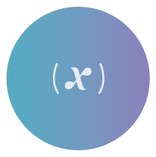




Programming in Python
Variables
Data Types
Operators
Conditions
Loops
lambda
Function
lambda function
Date-time
Notes:
Two basic modes:
Interactive: Quick way of writing and testing code. Interactive in nature and gives results on the fly.
Interactive mode is recommended when some idea/result is to be quickly tested.
Script: Write complete code just like in any other language. Run all or some part of the code.
Code can be stored in scripts and run at a later time.
Python scripts end with a .py extension

Slide 19
Programming in Python
Variables
Data Types
Operators
Conditions
Loops
lambda
Function
lambda function
Date-time
Notes:
Two basic modes:
Interactive: Quick way of writing and testing code. Interactive in nature and gives results on the fly.
Interactive mode is recommended when some idea/result is to be quickly tested.
Script: Write complete code just like in any other language. Run all or some part of the code.
Code can be stored in scripts and run at a later time.
Python scripts end with a .py extension

Slide 20
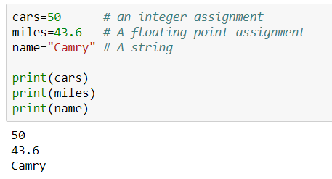
Variables
Variables are reserved memory locations to store values
cars = 50
miles = 43.60
name = “Camry”
Notes:
Two basic modes:
Interactive: Quick way of writing and testing code. Interactive in nature and gives results on the fly.
Interactive mode is recommended when some idea/result is to be quickly tested.
Script: Write complete code just like in any other language. Run all or some part of the code.
Code can be stored in scripts and run at a later time.
Python scripts end with a .py extension

Slide 21
Programming in Python
Variables
Data Types
Operators
Conditions
Loops
lambda
Function
lambda function
Date-time
Notes:
Two basic modes:
Interactive: Quick way of writing and testing code. Interactive in nature and gives results on the fly.
Interactive mode is recommended when some idea/result is to be quickly tested.
Script: Write complete code just like in any other language. Run all or some part of the code.
Code can be stored in scripts and run at a later time.
Python scripts end with a .py extension

Slide 22





Data Types
A classification to specify which type of a value a variable has
Numeric
List
Tuple
Strings
Dictionary
Notes:
Two basic modes:
Interactive: Quick way of writing and testing code. Interactive in nature and gives results on the fly.
Interactive mode is recommended when some idea/result is to be quickly tested.
Script: Write complete code just like in any other language. Run all or some part of the code.
Code can be stored in scripts and run at a later time.
Python scripts end with a .py extension

Slide 23
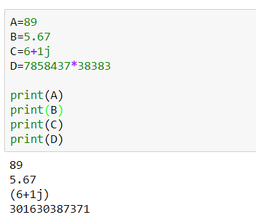
Data Types
Numeric
Data Type
Store numeric values
Integer type [A = 89]
Float type [B = 5.67]
Complex type [C = 6 + i]
Long type [D = 785843*38383 ]
Notes:
Two basic modes:
Interactive: Quick way of writing and testing code. Interactive in nature and gives results on the fly.
Interactive mode is recommended when some idea/result is to be quickly tested.
Script: Write complete code just like in any other language. Run all or some part of the code.
Code can be stored in scripts and run at a later time.
Python scripts end with a .py extension

Slide 24
Data Types
List Data Type
Sequence of comma separated values (items) between square brackets
Eg. Recommending a list of fruits for a diet regimen
list_fruits = [‘orange’ , ‘apple’ , ‘mango’]
Notes:
Two basic modes:
Interactive: Quick way of writing and testing code. Interactive in nature and gives results on the fly.
Interactive mode is recommended when some idea/result is to be quickly tested.
Script: Write complete code just like in any other language. Run all or some part of the code.
Code can be stored in scripts and run at a later time.
Python scripts end with a .py extension

Slide 25






Data Types
List Operations
Access values
Delete elements
Concatenation
Update
Length
Repetition
Notes:
Two basic modes:
Interactive: Quick way of writing and testing code. Interactive in nature and gives results on the fly.
Interactive mode is recommended when some idea/result is to be quickly tested.
Script: Write complete code just like in any other language. Run all or some part of the code.
Code can be stored in scripts and run at a later time.
Python scripts end with a .py extension

Slide 26
Data Types
List Data Type
The list is a datatype written as a sequence of comma-separated values (items) between square brackets.
Notes:
Two basic modes:
Interactive: Quick way of writing and testing code. Interactive in nature and gives results on the fly.
Interactive mode is recommended when some idea/result is to be quickly tested.
Script: Write complete code just like in any other language. Run all or some part of the code.
Code can be stored in scripts and run at a later time.
Python scripts end with a .py extension

Slide 27
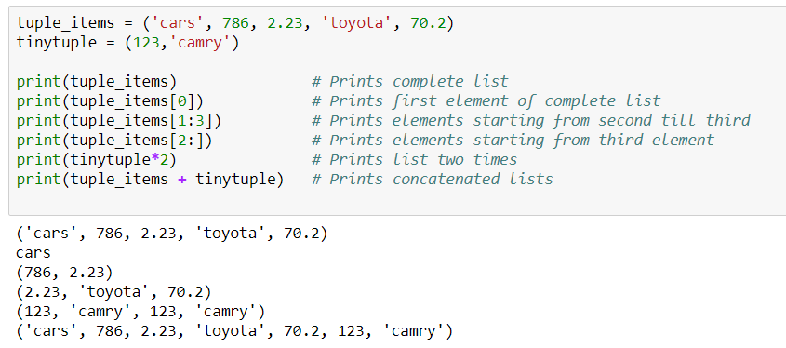
Data Types
List Data Type
Notes:
Two basic modes:
Interactive: Quick way of writing and testing code. Interactive in nature and gives results on the fly.
Interactive mode is recommended when some idea/result is to be quickly tested.
Script: Write complete code just like in any other language. Run all or some part of the code.
Code can be stored in scripts and run at a later time.
Python scripts end with a .py extension

Slide 28


Data Types
Tuple Data Type
An unchangeable object whose state cannot be modified after it is created (enclosed in parentheses)
A tuple is a sequence of Immutable Python objects
List
Tuple
Stores ingredients to cook noodles, because they can change.
Stores latitude and longitude of your home, because it doesn’t.
Notes:
Two basic modes:
Interactive: Quick way of writing and testing code. Interactive in nature and gives results on the fly.
Interactive mode is recommended when some idea/result is to be quickly tested.
Script: Write complete code just like in any other language. Run all or some part of the code.
Code can be stored in scripts and run at a later time.
Python scripts end with a .py extension

Slide 29
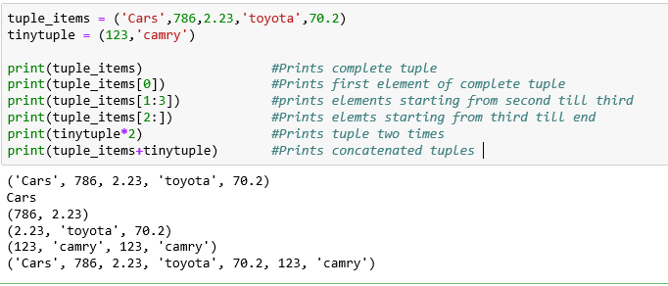
Data Types
Tuple Data Type
Tuples are enclosed in parentheses and cannot be updated
Notes:
Two basic modes:
Interactive: Quick way of writing and testing code. Interactive in nature and gives results on the fly.
Interactive mode is recommended when some idea/result is to be quickly tested.
Script: Write complete code just like in any other language. Run all or some part of the code.
Code can be stored in scripts and run at a later time.
Python scripts end with a .py extension

Slide 30
Data Types
String Data Type
A string in Python is a sequence of characters
Single line Strings
A = “Mastering Python”
Strings are created by enclosing characters in quotes
Python treats single quotes the same as double quotes
Multi line Strings
B = “““ Mastering Python
takes time”””
Notes:
Two basic modes:
Interactive: Quick way of writing and testing code. Interactive in nature and gives results on the fly.
Interactive mode is recommended when some idea/result is to be quickly tested.
Script: Write complete code just like in any other language. Run all or some part of the code.
Code can be stored in scripts and run at a later time.
Python scripts end with a .py extension

Slide 31
Data Types
String Data Type
Subsets of strings can be taken using the slice operator ( [ ] and [:] ) with indexes starting at 0 in the beginning of the string and working their way from -1 at the end.
Notes:
Two basic modes:
Interactive: Quick way of writing and testing code. Interactive in nature and gives results on the fly.
Interactive mode is recommended when some idea/result is to be quickly tested.
Script: Write complete code just like in any other language. Run all or some part of the code.
Code can be stored in scripts and run at a later time.
Python scripts end with a .py extension

Slide 32
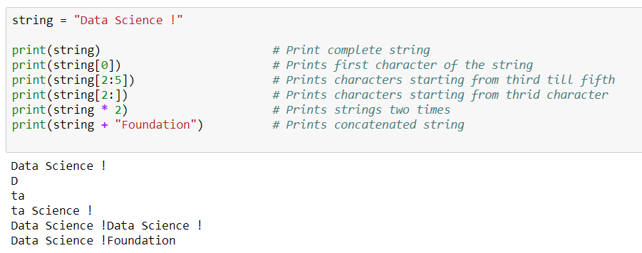
Data Types
String Data Type
Notes:
Two basic modes:
Interactive: Quick way of writing and testing code. Interactive in nature and gives results on the fly.
Interactive mode is recommended when some idea/result is to be quickly tested.
Script: Write complete code just like in any other language. Run all or some part of the code.
Code can be stored in scripts and run at a later time.
Python scripts end with a .py extension

Slide 33

Data Types
Dictionary Data Type
Dictionary is an unordered collection of key value pairs.
A dictionary usually comprises of data that come in pairs
A person’s name & birthday
Bdays = {'Bob':'8 Jan 1967','Manoj': '15 Aug 1987'}
An animal and it’s associated species
animals={’Husky':'dog','Cockroach':'insects'}
Notes:
Two basic modes:
Interactive: Quick way of writing and testing code. Interactive in nature and gives results on the fly.
Interactive mode is recommended when some idea/result is to be quickly tested.
Script: Write complete code just like in any other language. Run all or some part of the code.
Code can be stored in scripts and run at a later time.
Python scripts end with a .py extension

Slide 34
Data Types
Dictionary Data Type
Dictionaries are enclosed by curly braces { } and values can be assigned and accessed using square braces [ ]
Notes:
Two basic modes:
Interactive: Quick way of writing and testing code. Interactive in nature and gives results on the fly.
Interactive mode is recommended when some idea/result is to be quickly tested.
Script: Write complete code just like in any other language. Run all or some part of the code.
Code can be stored in scripts and run at a later time.
Python scripts end with a .py extension

Slide 35
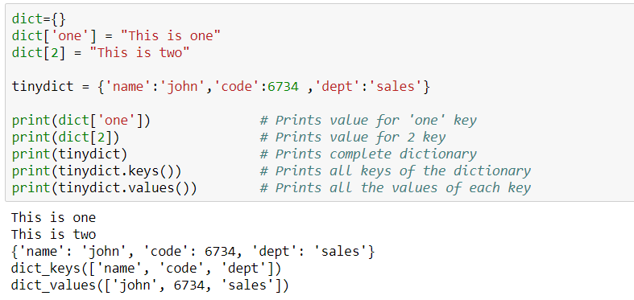
Data Types
Dictionary
Data Type
Notes:
Two basic modes:
Interactive: Quick way of writing and testing code. Interactive in nature and gives results on the fly.
Interactive mode is recommended when some idea/result is to be quickly tested.
Script: Write complete code just like in any other language. Run all or some part of the code.
Code can be stored in scripts and run at a later time.
Python scripts end with a .py extension

Slide 36
Programming in Python
Variables
Data Types
Operators
Conditions
Loops
lambda
Function
lambda function
Date-time
Notes:
Two basic modes:
Interactive: Quick way of writing and testing code. Interactive in nature and gives results on the fly.
Interactive mode is recommended when some idea/result is to be quickly tested.
Script: Write complete code just like in any other language. Run all or some part of the code.
Code can be stored in scripts and run at a later time.
Python scripts end with a .py extension

Slide 37
Operators
Operators are constructs that can manipulate the value of operations
Comparison
Arithmetic
Assignment
Identity
Logical
Notes:
Two basic modes:
Interactive: Quick way of writing and testing code. Interactive in nature and gives results on the fly.
Interactive mode is recommended when some idea/result is to be quickly tested.
Script: Write complete code just like in any other language. Run all or some part of the code.
Code can be stored in scripts and run at a later time.
Python scripts end with a .py extension

Slide 38


Operators
Assignment and Identity Operators
a = a + b
points to true if variables on either side of the operator points to the same object and points false otherwise
Assigns values from right to left a=b
a = a - b
a = a * b
a = a / b
points to true if variables on either side of the operator points to different objects
a = a** b
Notes:
Two basic modes:
Interactive: Quick way of writing and testing code. Interactive in nature and gives results on the fly.
Interactive mode is recommended when some idea/result is to be quickly tested.
Script: Write complete code just like in any other language. Run all or some part of the code.
Code can be stored in scripts and run at a later time.
Python scripts end with a .py extension

Slide 39
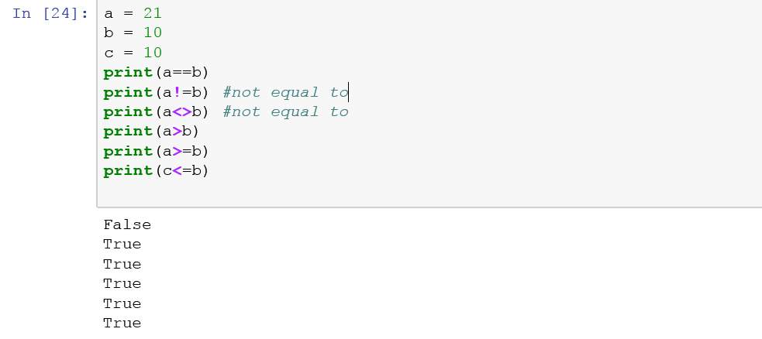
Operators
Comparison Operators
Notes:
Two basic modes:
Interactive: Quick way of writing and testing code. Interactive in nature and gives results on the fly.
Interactive mode is recommended when some idea/result is to be quickly tested.
Script: Write complete code just like in any other language. Run all or some part of the code.
Code can be stored in scripts and run at a later time.
Python scripts end with a .py extension

Slide 40
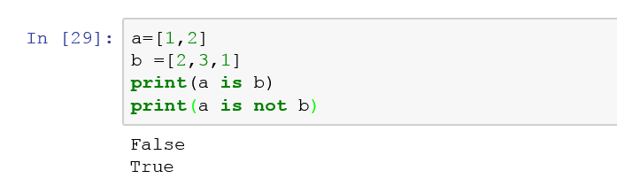
Operators
Identity Operators
Notes:
Two basic modes:
Interactive: Quick way of writing and testing code. Interactive in nature and gives results on the fly.
Interactive mode is recommended when some idea/result is to be quickly tested.
Script: Write complete code just like in any other language. Run all or some part of the code.
Code can be stored in scripts and run at a later time.
Python scripts end with a .py extension

Slide 41






Operators
Arithmetic
& Comparison
Operators
Addition a = a + b
Subtraction a = a - b
Multiplication a = a * b
Division a = a / b
Modulus a = a % b
Exponent a = a ** b
Notes:
Two basic modes:
Interactive: Quick way of writing and testing code. Interactive in nature and gives results on the fly.
Interactive mode is recommended when some idea/result is to be quickly tested.
Script: Write complete code just like in any other language. Run all or some part of the code.
Code can be stored in scripts and run at a later time.
Python scripts end with a .py extension

Slide 42






Operators
Arithmetic
& Comparison
Operators
Equal to a = b
Not equal to a != b
Greater than a > b
Lesser than a < b
Greater than equal to a >= b
Lesser than equal to a <= b
Notes:
Two basic modes:
Interactive: Quick way of writing and testing code. Interactive in nature and gives results on the fly.
Interactive mode is recommended when some idea/result is to be quickly tested.
Script: Write complete code just like in any other language. Run all or some part of the code.
Code can be stored in scripts and run at a later time.
Python scripts end with a .py extension

Slide 43
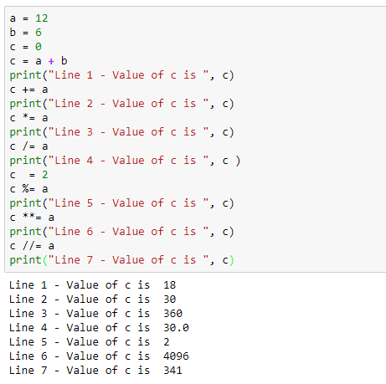
Operators
Assignment Operators
Notes:
Two basic modes:
Interactive: Quick way of writing and testing code. Interactive in nature and gives results on the fly.
Interactive mode is recommended when some idea/result is to be quickly tested.
Script: Write complete code just like in any other language. Run all or some part of the code.
Code can be stored in scripts and run at a later time.
Python scripts end with a .py extension

Slide 44
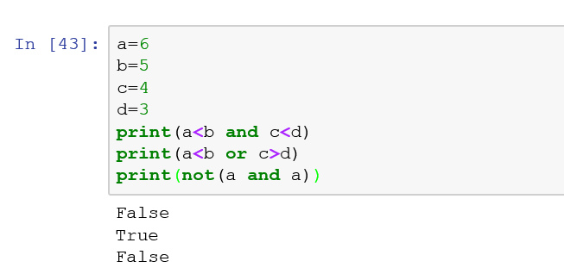



Operators
Logical Operators
Notes:
Two basic modes:
Interactive: Quick way of writing and testing code. Interactive in nature and gives results on the fly.
Interactive mode is recommended when some idea/result is to be quickly tested.
Script: Write complete code just like in any other language. Run all or some part of the code.
Code can be stored in scripts and run at a later time.
Python scripts end with a .py extension

Slide 45
Programming in Python
Variables
Data Types
Operators
Conditions
Loops
lambda
Function
lambda function
Date-time
Notes:
Two basic modes:
Interactive: Quick way of writing and testing code. Interactive in nature and gives results on the fly.
Interactive mode is recommended when some idea/result is to be quickly tested.
Script: Write complete code just like in any other language. Run all or some part of the code.
Code can be stored in scripts and run at a later time.
Python scripts end with a .py extension

Slide 46


Conditional Statements
Conditional statements decide the flow of the program based on some rules
This is done with the help of if-else statements
Notes:
Two basic modes:
Interactive: Quick way of writing and testing code. Interactive in nature and gives results on the fly.
Interactive mode is recommended when some idea/result is to be quickly tested.
Script: Write complete code just like in any other language. Run all or some part of the code.
Code can be stored in scripts and run at a later time.
Python scripts end with a .py extension

Slide 47
Conditional Statements
Python if statement is used to conditionally execute a block of code.
If statement contains a logical expression or condition, depending on which decisions are made.
If I get at least 10 rupees, I will buy chocolate,
else I will buy candy
Notes:
Two basic modes:
Interactive: Quick way of writing and testing code. Interactive in nature and gives results on the fly.
Interactive mode is recommended when some idea/result is to be quickly tested.
Script: Write complete code just like in any other language. Run all or some part of the code.
Code can be stored in scripts and run at a later time.
Python scripts end with a .py extension

Slide 48

Conditional Statements
Syntax:
if (expression):
statements(s)
else:
statements(s)
Test
Expression
False
True
Body of else
Body of if
Notes:
Two basic modes:
Interactive: Quick way of writing and testing code. Interactive in nature and gives results on the fly.
Interactive mode is recommended when some idea/result is to be quickly tested.
Script: Write complete code just like in any other language. Run all or some part of the code.
Code can be stored in scripts and run at a later time.
Python scripts end with a .py extension

Slide 49

Conditional Statements
Syntax:
if (expression):
statement(s)
elif (expression):
statement(s)
elif (expression):
statement(s)
else:
statement(s)
if
condition
False
elif
condition
False
True
Body of if
Body of else
True
Body of elif
Notes:
Two basic modes:
Interactive: Quick way of writing and testing code. Interactive in nature and gives results on the fly.
Interactive mode is recommended when some idea/result is to be quickly tested.
Script: Write complete code just like in any other language. Run all or some part of the code.
Code can be stored in scripts and run at a later time.
Python scripts end with a .py extension

Slide 50
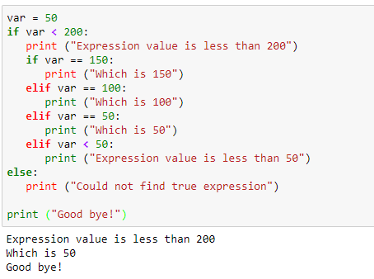
Conditional Statements
Notes:
Two basic modes:
Interactive: Quick way of writing and testing code. Interactive in nature and gives results on the fly.
Interactive mode is recommended when some idea/result is to be quickly tested.
Script: Write complete code just like in any other language. Run all or some part of the code.
Code can be stored in scripts and run at a later time.
Python scripts end with a .py extension

Slide 51
Programming in Python
Variables
Data Types
Operators
Conditions
Loops
lambda
Function
lambda function
Date-time
Notes:
Two basic modes:
Interactive: Quick way of writing and testing code. Interactive in nature and gives results on the fly.
Interactive mode is recommended when some idea/result is to be quickly tested.
Script: Write complete code just like in any other language. Run all or some part of the code.
Code can be stored in scripts and run at a later time.
Python scripts end with a .py extension

Slide 52
Loops
Loops
Loops are code blocks that are performed repeatedly a certain number of times
A music player and an associated playlist
illustrates the concept of loops
while (user does NOT press stop
AND NOT end of playlist)
{ get the next song play the song }
Notes:
Two basic modes:
Interactive: Quick way of writing and testing code. Interactive in nature and gives results on the fly.
Interactive mode is recommended when some idea/result is to be quickly tested.
Script: Write complete code just like in any other language. Run all or some part of the code.
Code can be stored in scripts and run at a later time.
Python scripts end with a .py extension

Slide 53

Loops
Loop
Syntax:
while (condition)
{
statements(s)
}
Enter while looping
While loop executes a code block within it, until the condition returns True and gets out of the loop once the condition returns False
Test
Expression
False
True
Exit loop
Body of while
Notes:
Two basic modes:
Interactive: Quick way of writing and testing code. Interactive in nature and gives results on the fly.
Interactive mode is recommended when some idea/result is to be quickly tested.
Script: Write complete code just like in any other language. Run all or some part of the code.
Code can be stored in scripts and run at a later time.
Python scripts end with a .py extension

Slide 54

Loops
Loop
Syntax:
for (initialization;
condition;
propagation)
{
statements(s)
}
For each item
in sequence
For loop executes a code block within it, until the number of iterations specified by the user
Last item
reached?
Yes
No
Exit loop
Body of for
Notes:
Two basic modes:
Interactive: Quick way of writing and testing code. Interactive in nature and gives results on the fly.
Interactive mode is recommended when some idea/result is to be quickly tested.
Script: Write complete code just like in any other language. Run all or some part of the code.
Code can be stored in scripts and run at a later time.
Python scripts end with a .py extension

Slide 55
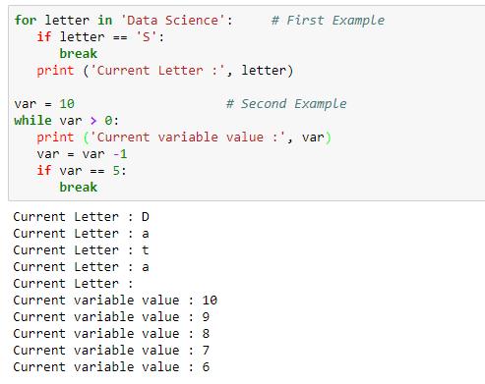
Loops
Loop
Notes:
Two basic modes:
Interactive: Quick way of writing and testing code. Interactive in nature and gives results on the fly.
Interactive mode is recommended when some idea/result is to be quickly tested.
Script: Write complete code just like in any other language. Run all or some part of the code.
Code can be stored in scripts and run at a later time.
Python scripts end with a .py extension

Slide 56
Programming in Python
Variables
Data Types
Operators
Conditions
Loops
lambda
Function
lambda function
Date-time
Notes:
Two basic modes:
Interactive: Quick way of writing and testing code. Interactive in nature and gives results on the fly.
Interactive mode is recommended when some idea/result is to be quickly tested.
Script: Write complete code just like in any other language. Run all or some part of the code.
Code can be stored in scripts and run at a later time.
Python scripts end with a .py extension

Slide 57
Functions
Functions
Functions are reusable piece of software
Block of statements that accepts some arguments, perform some functionality, and provides the output
Defined using def keyword
Notes:
Two basic modes:
Interactive: Quick way of writing and testing code. Interactive in nature and gives results on the fly.
Interactive mode is recommended when some idea/result is to be quickly tested.
Script: Write complete code just like in any other language. Run all or some part of the code.
Code can be stored in scripts and run at a later time.
Python scripts end with a .py extension

Slide 58
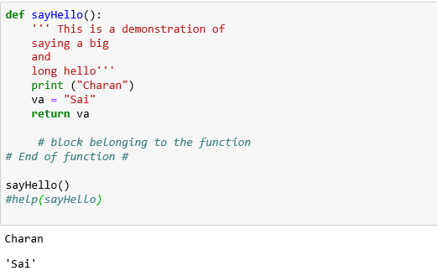
Functions
Functions
Notes:
Two basic modes:
Interactive: Quick way of writing and testing code. Interactive in nature and gives results on the fly.
Interactive mode is recommended when some idea/result is to be quickly tested.
Script: Write complete code just like in any other language. Run all or some part of the code.
Code can be stored in scripts and run at a later time.
Python scripts end with a .py extension

Slide 59
Programming in Python
Variables
Data Types
Operators
Conditions
Loops
lambda
Function
lambda function
Date-time
Notes:
Two basic modes:
Interactive: Quick way of writing and testing code. Interactive in nature and gives results on the fly.
Interactive mode is recommended when some idea/result is to be quickly tested.
Script: Write complete code just like in any other language. Run all or some part of the code.
Code can be stored in scripts and run at a later time.
Python scripts end with a .py extension

Slide 60
Lambda Function
Lambda Function
A lambda function is a piece of code that contain only a single expression and can take any number of arguments
lambda arguments: expression
Notes:
Two basic modes:
Interactive: Quick way of writing and testing code. Interactive in nature and gives results on the fly.
Interactive mode is recommended when some idea/result is to be quickly tested.
Script: Write complete code just like in any other language. Run all or some part of the code.
Code can be stored in scripts and run at a later time.
Python scripts end with a .py extension

Slide 61
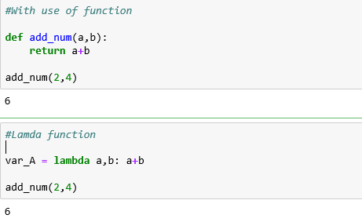
Lambda Function
Lambda Function
Notes:
Two basic modes:
Interactive: Quick way of writing and testing code. Interactive in nature and gives results on the fly.
Interactive mode is recommended when some idea/result is to be quickly tested.
Script: Write complete code just like in any other language. Run all or some part of the code.
Code can be stored in scripts and run at a later time.
Python scripts end with a .py extension

Slide 62
Programming in Python
Variables
Data Types
Operators
Conditions
Loops
lambda
Function
lambda function
Date-time
Notes:
Two basic modes:
Interactive: Quick way of writing and testing code. Interactive in nature and gives results on the fly.
Interactive mode is recommended when some idea/result is to be quickly tested.
Script: Write complete code just like in any other language. Run all or some part of the code.
Code can be stored in scripts and run at a later time.
Python scripts end with a .py extension

Slide 63
Date Time
Date-time
Python has a built-in date time module for working with dates and times
Python offers very powerful and flexible date time capabilities
Date-time is capable of operating at a scale of time measured in Nano-seconds
Notes:
Two basic modes:
Interactive: Quick way of writing and testing code. Interactive in nature and gives results on the fly.
Interactive mode is recommended when some idea/result is to be quickly tested.
Script: Write complete code just like in any other language. Run all or some part of the code.
Code can be stored in scripts and run at a later time.
Python scripts end with a .py extension

Slide 64
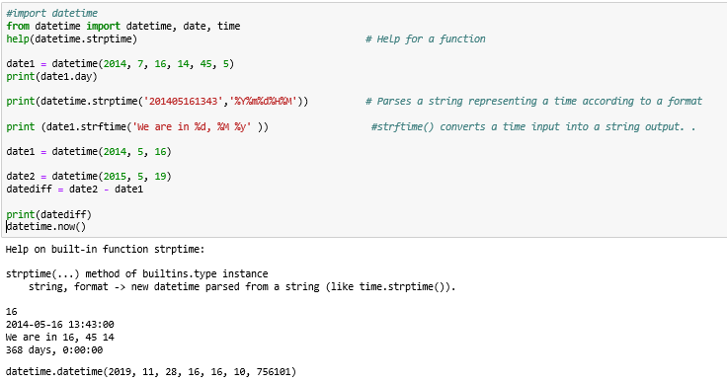
Date Time
Date Time
Notes:
Two basic modes:
Interactive: Quick way of writing and testing code. Interactive in nature and gives results on the fly.
Interactive mode is recommended when some idea/result is to be quickly tested.
Script: Write complete code just like in any other language. Run all or some part of the code.
Code can be stored in scripts and run at a later time.
Python scripts end with a .py extension

Slide 65


Points to Remember
Notes:
Two basic modes:`
Interactive: Quick way of writing and testing code. Interactive in nature and gives results on the fly.
Interactive mode is recommended when some idea/result is to be quickly tested.
Script: Write complete code just like in any other language. Run all or some part of the code.
Code can be stored in scripts and run at a later time.
Python scripts end with a .py extension

Slide 66
Points to Remember
Practice Everyday
Don’t overdo it
Solve it yourself
Get more information
Okay to be lost at first
Read
https://learnpythonthehardway.org/book/
Notes:
Two basic modes:`
Interactive: Quick way of writing and testing code. Interactive in nature and gives results on the fly.
Interactive mode is recommended when some idea/result is to be quickly tested.
Script: Write complete code just like in any other language. Run all or some part of the code.
Code can be stored in scripts and run at a later time.
Python scripts end with a .py extension

Slide 67
All the Best!
Notes:
Two basic modes:`
Interactive: Quick way of writing and testing code. Interactive in nature and gives results on the fly.
Interactive mode is recommended when some idea/result is to be quickly tested.
Script: Write complete code just like in any other language. Run all or some part of the code.
Code can be stored in scripts and run at a later time.
Python scripts end with a .py extension

